Slide 1
Peptic Ulcer Disease

Slide 2
Objectives
LO1:Definition of peptic ulcer
LO2:Pathophysiology of each type of peptic ulcer
LO3:Etiology of each type of peptic ulcer
LO4:Clinical presentation of gastric and duodenal ulcers.
LO5:Management.

Slide 3
What is PEPTIC ULCER ?????
Breaks in mucosal surface
>5mm in size
Depth till submucosa
In any part of GI tract exposed to aggressive action of acid pepsin juices.
Can be acute or chronic
Both can penetrate muscularis mucosa..

Slide 4
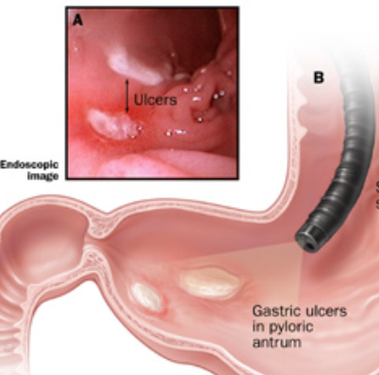
Peptic ulcer
Pepsin or HCl acid?
Peptic ulcer disease:
DU. 1st part of duodenum 80%.
GU. Lesser curve 19%.
Oesophagitis.
Stomal ulcer 1%.
Ectopic gastric mucosa in Meckel’s diverticulum.

Slide 5
Pathophysiology
Defensive
Bicarbonate
Mucus layer
Aggressive
Helicobacter pylori
NSAIDs
Mucosal blood flow
Prostaglandins
Epithelial renewal
Pepsins
Bile acids
Smoking and alcohol
Mucosal damage ➔ erosions & ulcerations

Slide 6
Etiology
H. Pylori
Hyperacidity
Drugs
NSAIDS
Corticosteroids
Systemic stresses
Cigarette smoking, Alcohol
Rapid gastric emptying
Personality and stress
No effect of genetics and spicy foods

Slide 7
Discovery of Helicobacter pylori
“Two Australian physicians won the 2005 Nobel Prize in Medicine or Physiology for showing - at least partly by accident -- that many ulcers are the result of a bacterial infection.”
Story from BBC NEWS: http://news.bbc.co.uk/go/pr/fr/-/2/hi/asia-pacific/4307826.stm Published: 2005/10/04 10:39:09 GMT © BBC MMVII
“Robin Warren and Barry Marshall's work on ulcers was pioneering”
Notes:
Dr. Warren, who retired in 1999 from his job as a pathologist at the Royal Perth Hospital, was the first to observe curved bacteria associated with the stomach epithelium of patients with peptic ulcers.
But the prevailing wisdom of the times was that ulcers were caused by stress and lifestyle, and his findings were dismissed, even ridiculed.
Dr. Marshall, currently a researcher at the University of Western Australia, near Perth, was intrigued by Dr. Warren's work and tried unsuccessfully to grow the bacteria in the lab. Then, over the Easter holiday in 1982, a set of culture plates was left in the incubator instead of being discarded.
When Dr. Marshall returned to the lab, he found that colonies of what would later be named Helicobacter pylori. The bacteria simply grew too slowly to be found by conventional methods.
The medical establishment said that bacteria couldn't survive -- let alone cause disease -- in the acidic environment of the stomach, so the next step should have been to test the hypothesis in animals.
Unfortunately, there were no animal models of ulcers. So Dr. Marshall took the unusual step of using himself as guinea pig and drank a solution containing the newly discovered bacteria.
"I planned to give myself an ulcer, then treat myself, to prove that H. pylori can be a pathogen in normal people," he once said. It didn't result in an ulcer - but the resulting stomach inflammation was clearly surrounded by the distinctive curved bacteria.
Currently, said Dr. Normark, the medical establishment recognizes that between 80% and 90% of all peptic ulcers are due to infection by H. pylori -- an understanding that has revolutionized the treatment of the condition.

Slide 8
H. pylori
Gram –ve
S-shaped , flagellate
H pylori is most common cause of PUD
Transmission route fecal-oral
Secretes urease →convert urea to ammonia
Produces alkaline environment enabling survival in stomach.
Notes:
Infection with Helicobacter pylori, a short, spiral-shaped, microaerophilic gram-negative bacillus, is the leading cause of PUD and is associated with virtually all ulcers not induced by NSAIDs. H pylori colonize the deep layers of the mucosal gel that coats the gastric mucosa and presumably disrupts its protective properties. H pylori is thought to infect virtually all patients with chronic active gastritis.

Slide 9
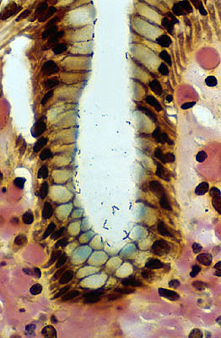
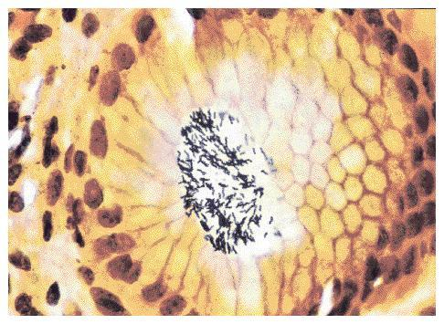
H. pylori – silver stain

Slide 10
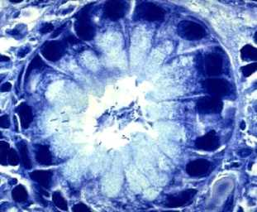
H. pylori – giemsa stain

Slide 11
H. pylori – H & E stain

Slide 12
Clinical Presentation

Slide 13
Gastric ulcer | Duodenal Ulcer
middle age 50-60 | Any age specially 30-40 | Age
More in male | More in male | Sex
Same | Stress job e.g. Manager | Occupation
Epi. Can radiate to back | Epigastric , discomfort | Pain
Immediately after eating | 2-3 hours after eating & midnight | Onset
Eating | Hunger | Agg.by

Slide 14
Gastric ulcer | Duodenal Ulcer
Lying down or vomiting | Eating | Relived by
Few weeks | 1-2 months | Duration
Common(to relieve the pain) | Uncommon | Vomiting
Pt. afraid to eat | Good | Appetite
Avoid fried food | Good , eat to relieve the pain | Diet
wt. Loss | No wt. loss | Weight
60% | 40% | Hematemesis
40% | 60% | Melena

Slide 15
Signs.
Physical examination is of limited value in patients with uncomplicated ulcer.
For epigastric tenderness on deep palpation, the sensitivity and specificity are all approximately 50% or less.
Furthermore, many patients with non-ulcer diseases also have epigastric tenderness on physical examination.

Slide 16
Diagnostic Evaluation

Slide 17
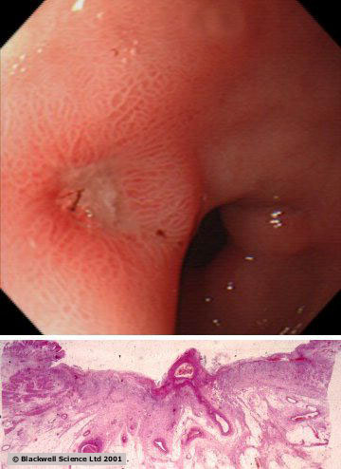
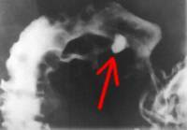
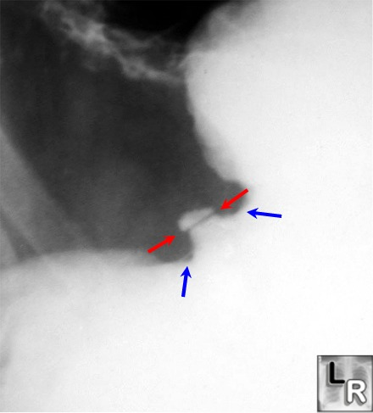
Barium studies of proximal GI
Endoscopy
Tests for detection of H.Pylori
Occasionally serum gastrin level
gastric acid analysis
screen for NSAIDs
Non invasive: serology
Urea breath test
Stool antigen
Invasive : rapid urease
histology
culture
Duodenal ulcer
Gastric ulcer

Slide 18
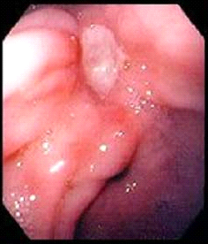
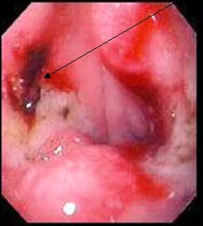
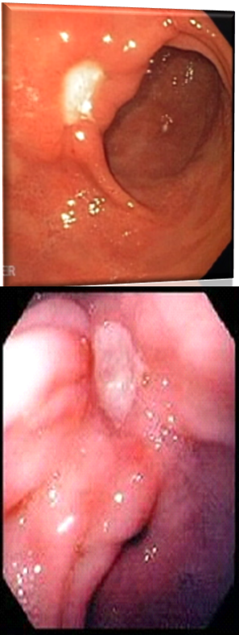
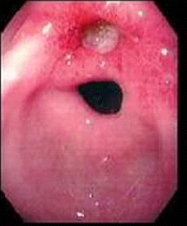
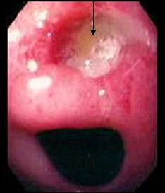
Gastric Ulcer Endoscopic Appearance

Slide 19
Gastric Ulcer
Chr. DU: NOT associated with Malignancy.
Chr. GU: Associated with Malignancy.
Which from which?
benign GU undergo malignant transformation?
Or
GU assessed by scope as benign and the biopsy reveal malignancy.( ulcerated cancer).

Slide 20
Gastric Ulcer
Any GU should be regarded as being malignant no matter how classically it appears like benign.
Multiple Bx at least 10 well targeted Bx before the ulcer accepted as being benign.
Anti ulcer Rx can heal ulceration associated with malignancy, but not Rx the malignancy.

Slide 21
Treatment

Slide 22
Acid Suppressing Drugs
Antacids
H2 Receptor antagonists
Proton Pump
Inhibitors (PPIs)
: Magnesium Hydroxide ,Aluminum Hydroxide
Sodium Bicarbonate
Calcium Carbonate
:100 – 150 meq/l 1 & 3 hrs after the meal.`
Cimetidine 400mg bid
Ranitidine 300mg
Famotidine 40mg
Nizatidine 300mg
Omeprazole 20mg/day
Lansoprazole 30mg/day
Rabiprazole 20mg/day
Pantoprazole 40mg/day
Esomeprazole 20mg/day

Slide 23
Regimens for Eradication
Of H.Pylori
Triple Therapy
Bismuth Subsalicylate + -2 tablets qid
Metronidazole + -250mg qid
Tetracycline -500mg qid
2 . Ranitidine Bismuth Citrate + -400mg bid
Tetracycline + -500mg bid
Clarithromycin / Metronidazole -500mg bid

Slide 24
Regimens for Eradication
Of H.Pylori
3. Omeprazole + - 20mg bid
Claithromycin + -250/500mg bid
Metronidazole / -500mg bid
Amoxicillin - 1gm bid

Slide 25
Mucosal Protective Agents
Sucralfate
Prostaglandin Analogue
Bismuth Containing Compounds
-Sucralfate – 1gm qid
-Misoprostol - 200μg qid

Slide 26
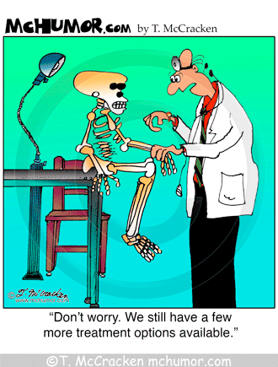
Quadruple therapy?
Sequential therapy?
Treatment of complications?
Therapy for NSAID? injury
Surgical Therapy!!!!!!

